Slide 1
STUXNET
Jordan Campagna, Joseph Clay, Lorna Galloway

Slide 2
WHAT IS STUXNET?
WORM
Exploited unknown Zero-Day vulnerabilities in PC’s
Targets enriched uranium centrifuges
Little or no harm when computer is not involved with uranium
Checks for PLC’s
Damages / destroys equipment
Hard to detect
Creators are unknown
Intelligence agencies in U.S. and Israel
“Operation Olympic Games”
Delay nuclear weapons in Iran
Notes:
Stuxnet is a computer worm, which is a specific type of standalone malware that replicates itself in order to spread to other computers.
It was designed to exploit zero day vulnerabilities, or flaws that are unknown to the developer, in Windows systems
Its main targets were connected to enriched uranium centrifuges that power nuclear weapons and reactors.
If a computer is not involved in this specific situation, there is little to no harm done when infected.
In order to differentiate this, the worm will check for Programmable Logic Controllers, or PLC’s, which allow computers to control industrial machinery.
Once a PLC is infected, the programming is altered, resulting in the equipment being damaged or destroyed. However, the controller computer believes that everything is in working order, which makes this worm hard to detect.
While the actual creators are unknown, it is widely believed and accepted that they were a team of ten working in the intelligence agencies of the US and Israel, and they would have worked on development over the course of 2-3 years.
Its code name in development was “Operation Olympic Games” which was started under Bush and continued under Obama, although this was never formally acknowledged.
Its intended purpose was to be used as a tool to delay the development of Iranian nuclear weapons.

Slide 3
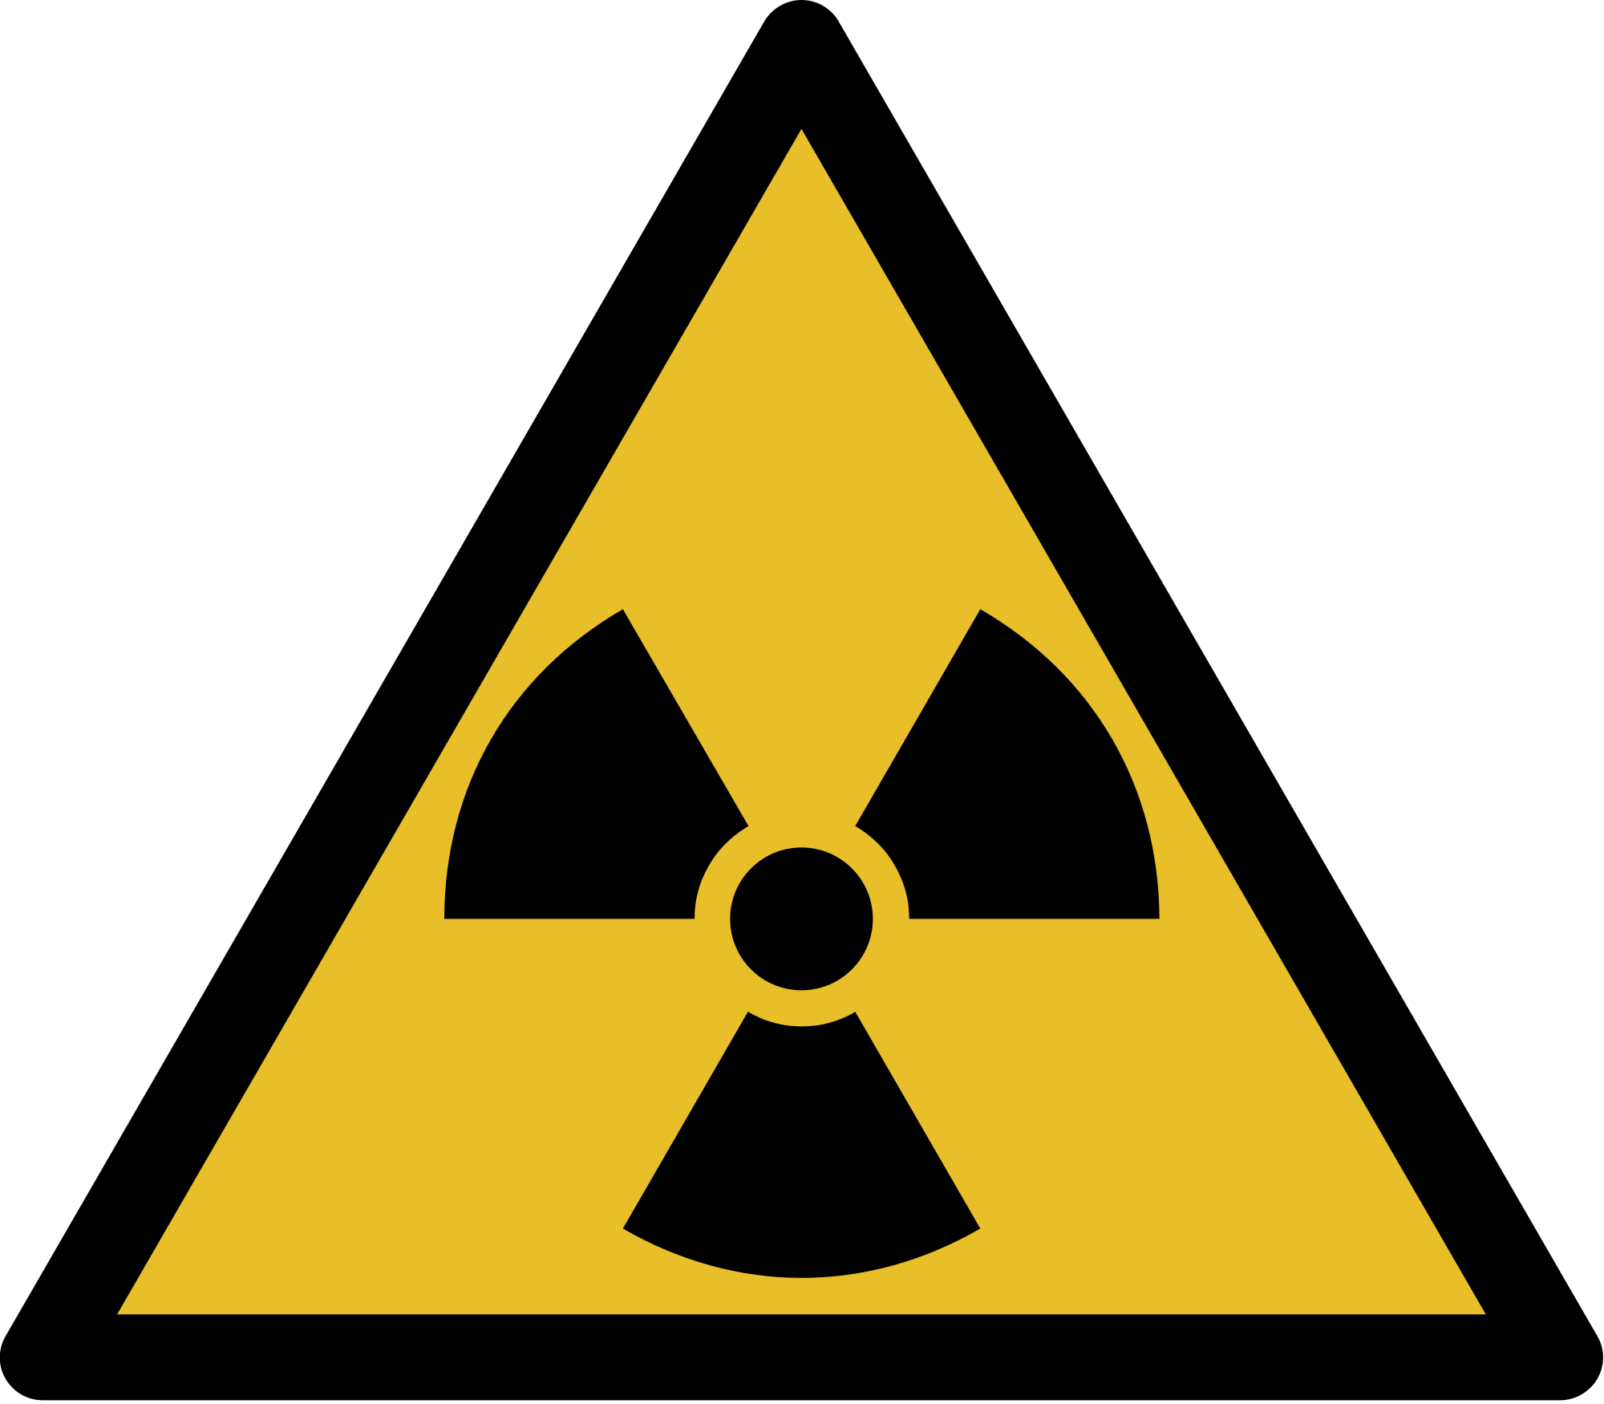
WHAT DAMAGE HAS IT DONE?
1st attack in 2010 at Natanz
Centrifuges failing & computers crashing
2nd attack spread via USB flash drives
5 different companies connected to nuclear program
Attacked 4 out of 5 Zero-Days
Centrifuges spun too fast & ruined samples
Wore down machines before their time
PLC’s still reading correctly
Estimated 984 centrifuges destroyed
Set back Iranian Nuclear program by several years
Notes:
The first attack happened to the Natanz uranium enrichment plant in Iran. They noticed that their centrifuges were failing at an alarming rate, and their computers began to crash and reboot, yet no one could determine why this was happening.
In the 2nd attack, the attackers used USB flash drives to infect the computers of five outside companies that they believed were connected to the nuclear program.
The worm would exploit zero-day vulnerabilities in either the victim’s Windows Autorun feature or their local network.
Then the victims would unknowingly spread the worm internally when inserting their flash drives all around the company. Stuxnet managed to attack 4 out of 5 zero-day vulnerabilities.
The worm worked by slowly but effectively damaging the centrifuges by causing them to spin too quickly, and then suddenly stop. They would repeat this motion every time a uranium sample was inserted, causing the machine to become worn out years before it was supposed to be.
Again, the PLC would read that everything was running smoothly, so there was no cause for concern until it was too late.
There were an estimated 984 uranium centrifuges that were destroyed over the course of Stuxnet’s run. Overall, the worm successfully set back the Iranian nuclear program by several years.

Slide 4
MITIGATING THE DAMAGE...
Review system upgrades for vulnerabilities
Patch all Zero-Day vulnerabilities
Strict management policy for USB devices
Disabling USB ports altogether
Defense-in-depth strategies including physical control, personnel policies, administrative controls, and firewalls, encryption, and antivirus tools
Application whitelisting
Unidirectional technology
Notes:
Although Stuxnet did so much damage, the 2nd attack was rushed by the developers, causing them to lose focus on keeping the worm under the radar, eventually aiding in its discovery.

Slide 5
SOURCES
CSO ONLINE
https://www.csoonline.com/article/3218104/what-is-stuxnet-who-created-it-and-how-does-it-work.html
WIRED
https://www.wired.com/2014/11/countdown-to-zero-day-stuxnet/
DIGITAL TRENDS
https://www.digitaltrends.com/computing/bits-before-bombs-how-stuxnet-crippled-irans-nuclear-dreams/
CISA
https://www.us-cert.gov/ics/advisories/ICSA-10-238-01B
AUTOMATION WORLD
https://www.automationworld.com/article/technologies/energy-management/defending-against-next-stuxnet

